Slide 1
Progress on building a neural-net ParFlow

Slide 2
ParFlow-CLM
3D variably saturated groundwater flow
Fully integrated surface water
Parallel implementation
Coupled land surface processes
Land-energy balance
Snow dynamics
Driven by meteorology
Maxwell (2013); Kollet and Maxwell (2008); Kollet and Maxwell (2006);Maxwell and Miller (2005); Dai et al. (2003); Jones and Woodward (2001); Ashby and Falgout (1996)
Notes:
Coupling with land surface processes (CLM) allows for simulation of interactions and connections

Slide 3
Methods
Pressure
Time series inputs
Model parameters/Topography
NN
Saturation
CLM

Slide 4
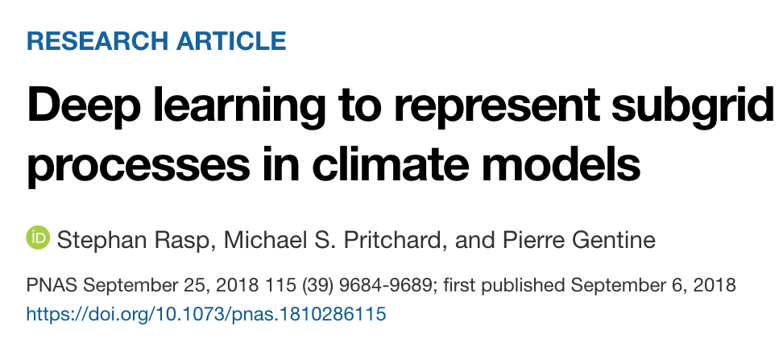
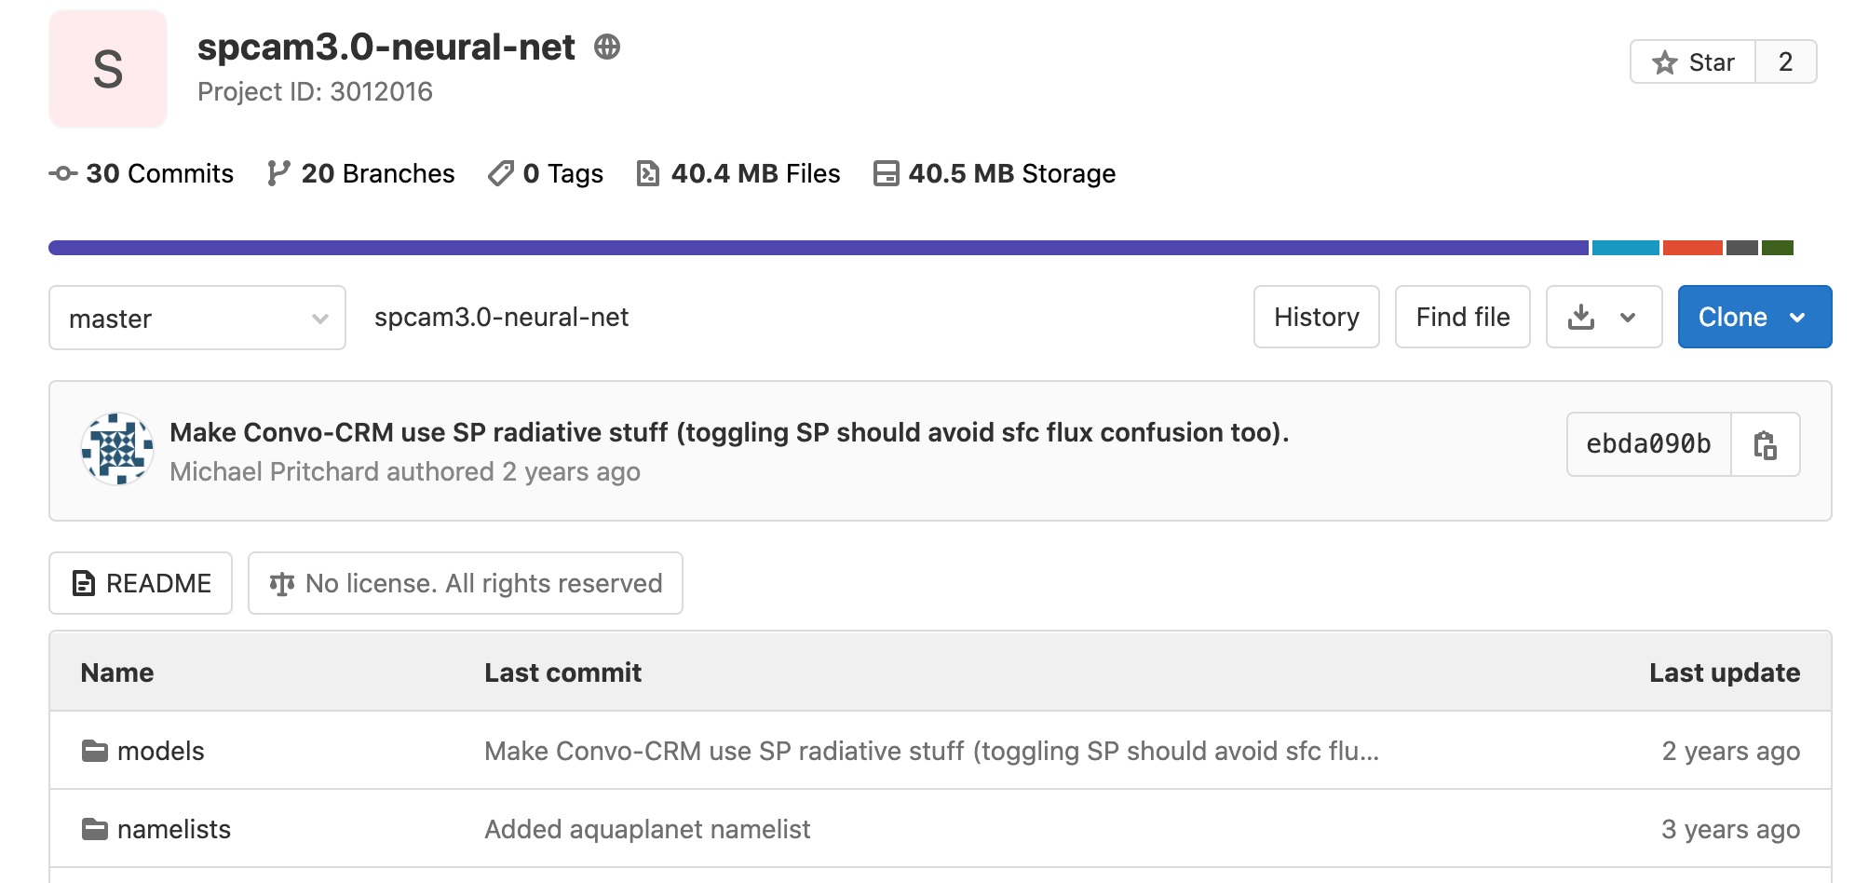
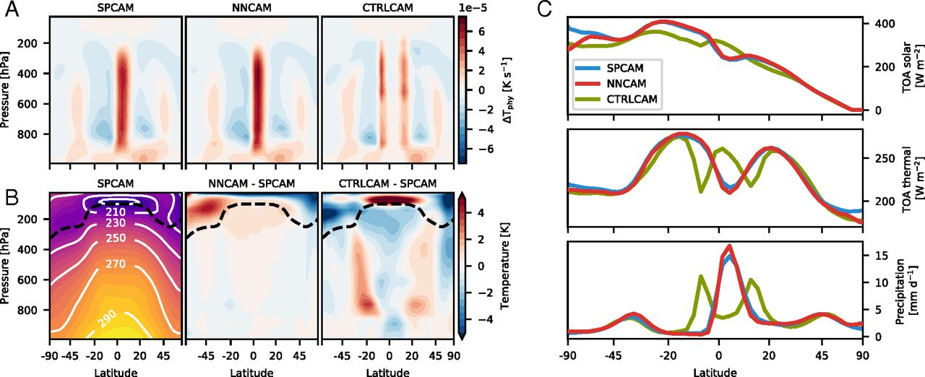
Motivation

Slide 5
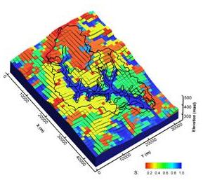
Start with Little Washita
Relatively small domain (41x41 km)
20-year CLM simulation

Slide 6
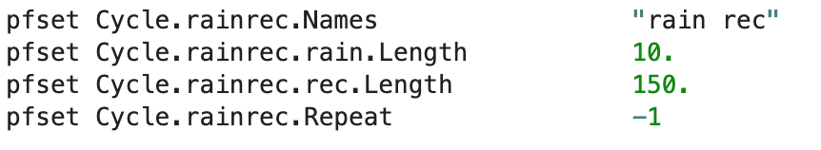
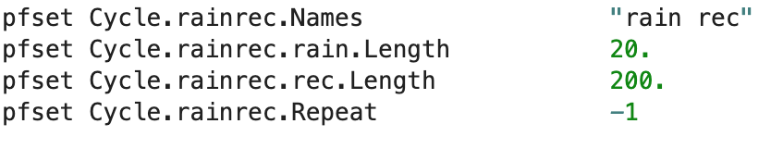
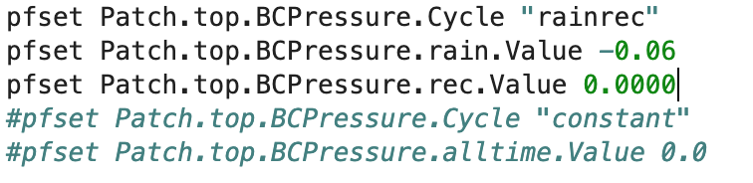
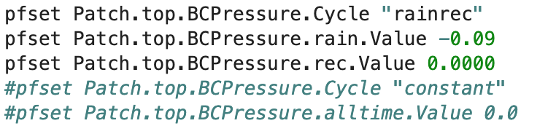
Just rainfall-recession first
Train
Test

Slide 7
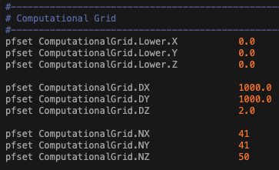
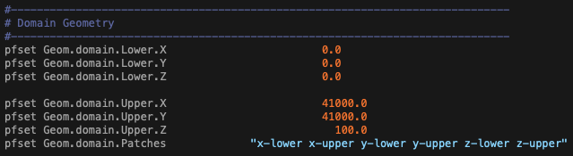
Parse information form a .tcl script (LW_Test.tcl) to create parameter files
Domain geometry

Slide 8
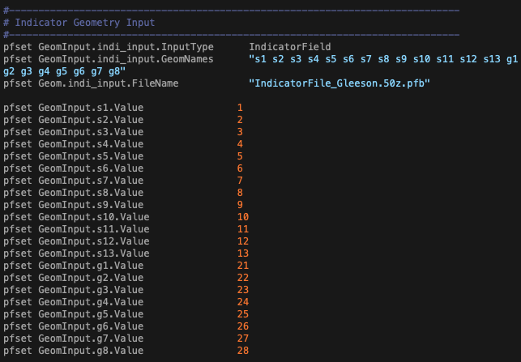
Parse information form a .tcl script (LW_Test.tcl) to create parameter files
Domain geometry
Indicator file

Slide 9
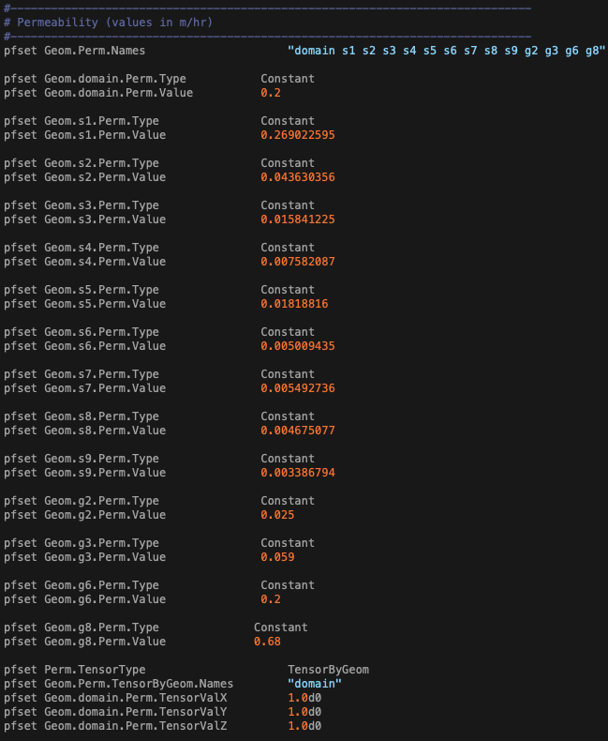
Parse information form a .tcl script (LW_Test.tcl) to create parameter files
Domain geometry
Indicator file
Permeability

Slide 10
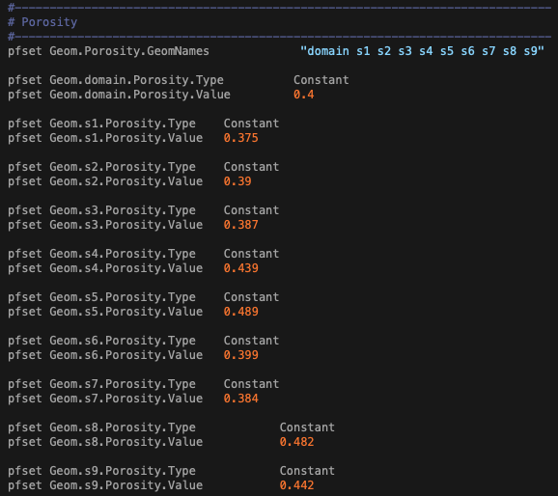
Parse information form a .tcl script (LW_Test.tcl) to create parameter files
Domain geometry
Indicator file
Porosity
Permeability

Slide 11
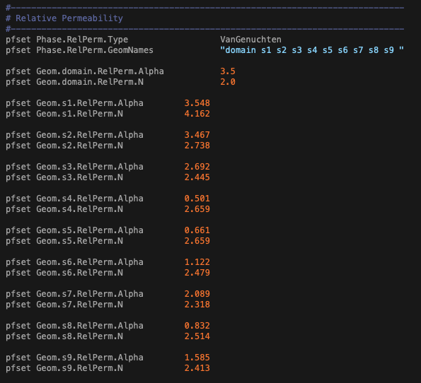
Parse information form a .tcl script (LW_Test.tcl) to create parameter files
Domain geometry
Indicator file
Saturation, etc.
Relative Permeability
Porosity
Permeability

Slide 12
Parse information form a .tcl script (LW_Test.tcl) to create parameter files
Domain geometry
Indicator file
Topo slopes
Initial pressure
Saturation, etc.
Relative Permeability
Porosity
Permeability

Slide 13
Parse information form a .tcl script (LW_Test.tcl) to create parameter files
Static .nc file
Domain geometry
3D Numpy array with dimensions of domain geometry
Indicator file
Topo slopes
Initial pressure
Saturation, etc.
Relative Permeability
Porosity
Permeability
Write ~0.01 s . Size 10.8 Mb

Slide 14
Parse information form a .tcl script (LW_Test.tcl) to create parameter files
Domain geometry
Forcing information
Forcing information
Forcing information
3D Numpy arrays (time x ny x nx)
Forcing .nc file
Write ~0.02 s . Size 13.5 Mb

Slide 15
Parse information form a .tcl script (LW_Test.tcl) to create parameter files
Model outputs
Domain geometry
Pressure
Outputs
Outputs
Read .pfb file + Stack up
Outputs
~ 5.9 s
2000 files, 673 Kb each
Saturation
4D Numpy arrays (time x nz x ny x nx)
Output .nc files
Write ~0.39 s . Size 673 Mb

Slide 16
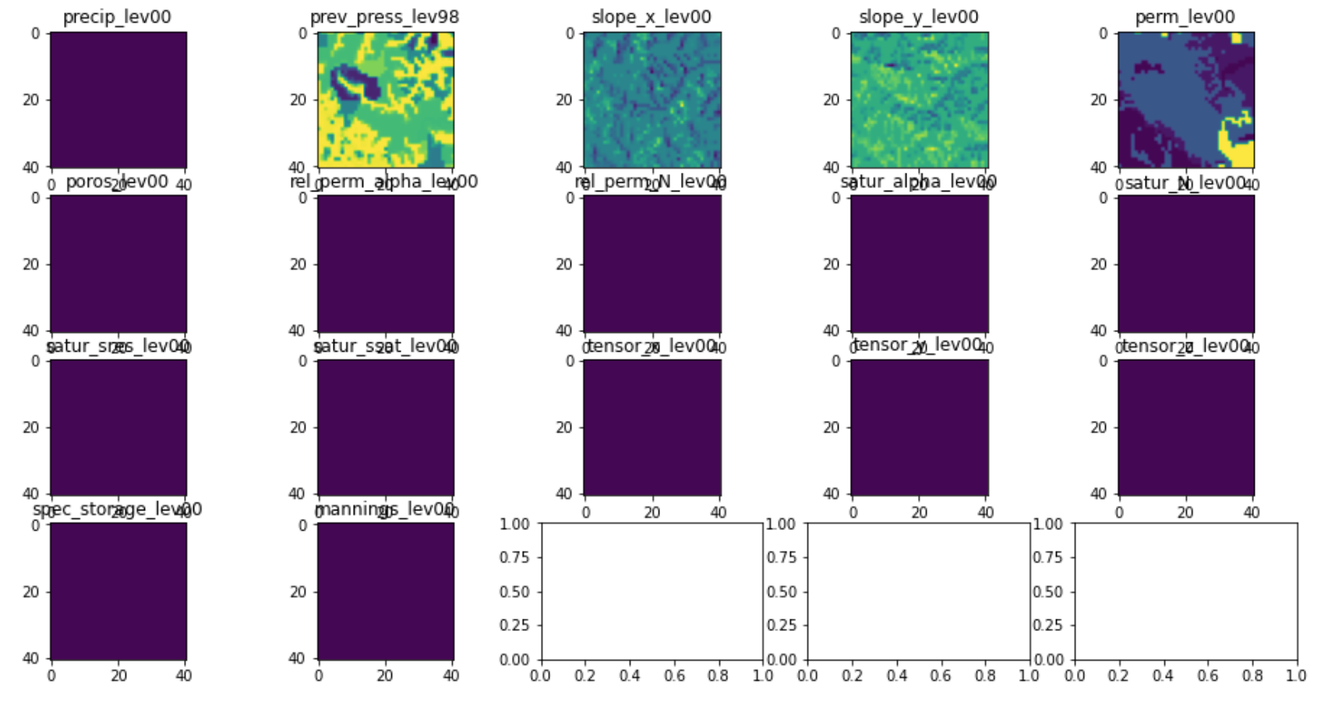
Parse information form a .tcl script to create .nc file
Static .nc file
Forcing .nc file
Output .nc file
Mostly for portability

Slide 17
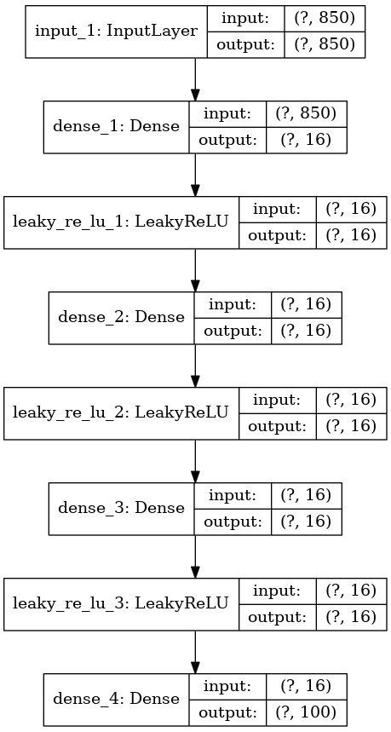
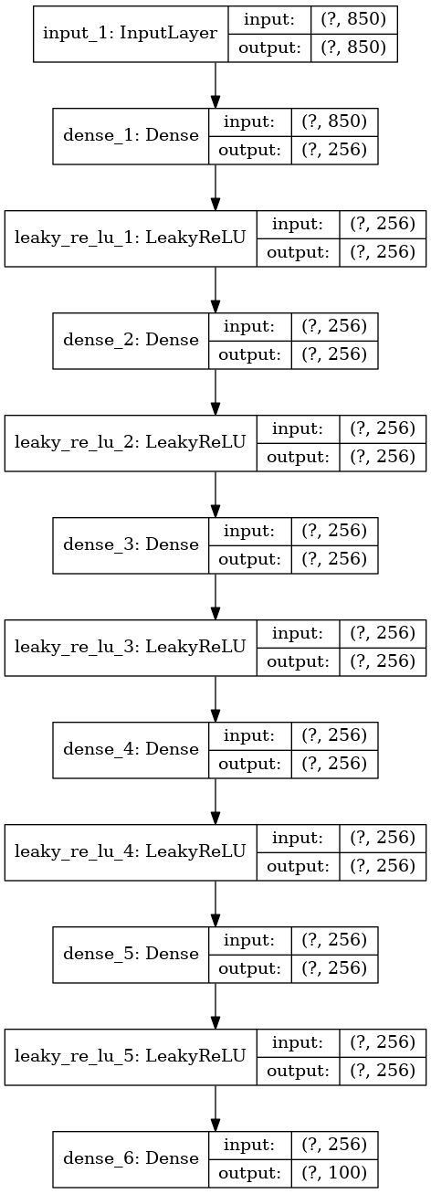
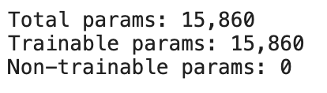
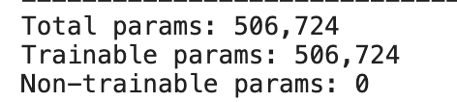
Follow the model architecture from Rasp et al.
Input: number of samples x number of feature
4D array (i.e. time*nz*ny*nx) for each feature was flatten out and count as number of samples

Slide 18
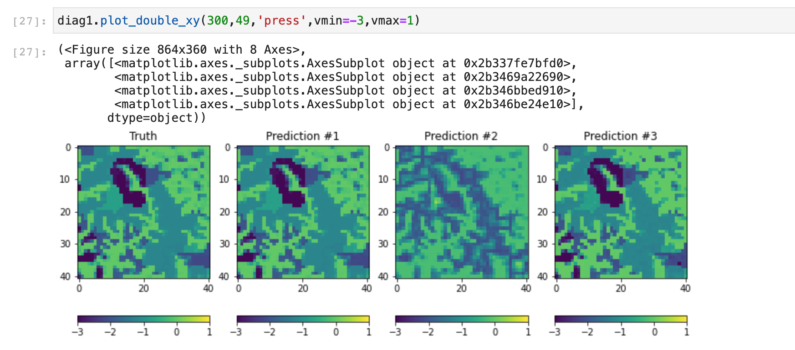
Follow the model architecture from Rasp et al.

Slide 19
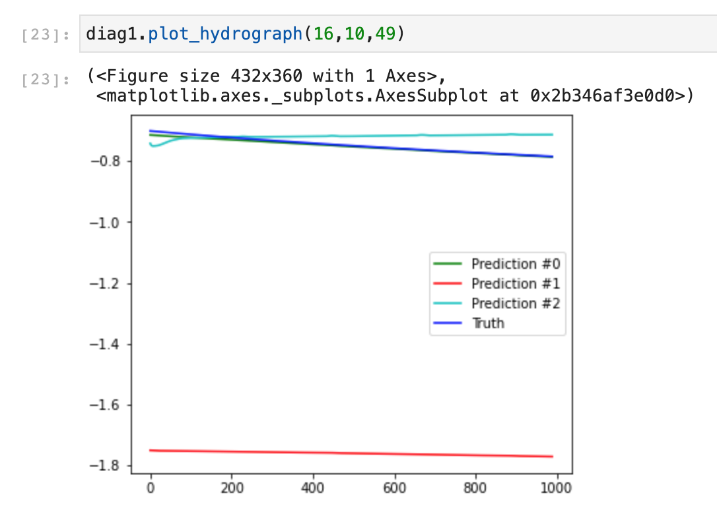
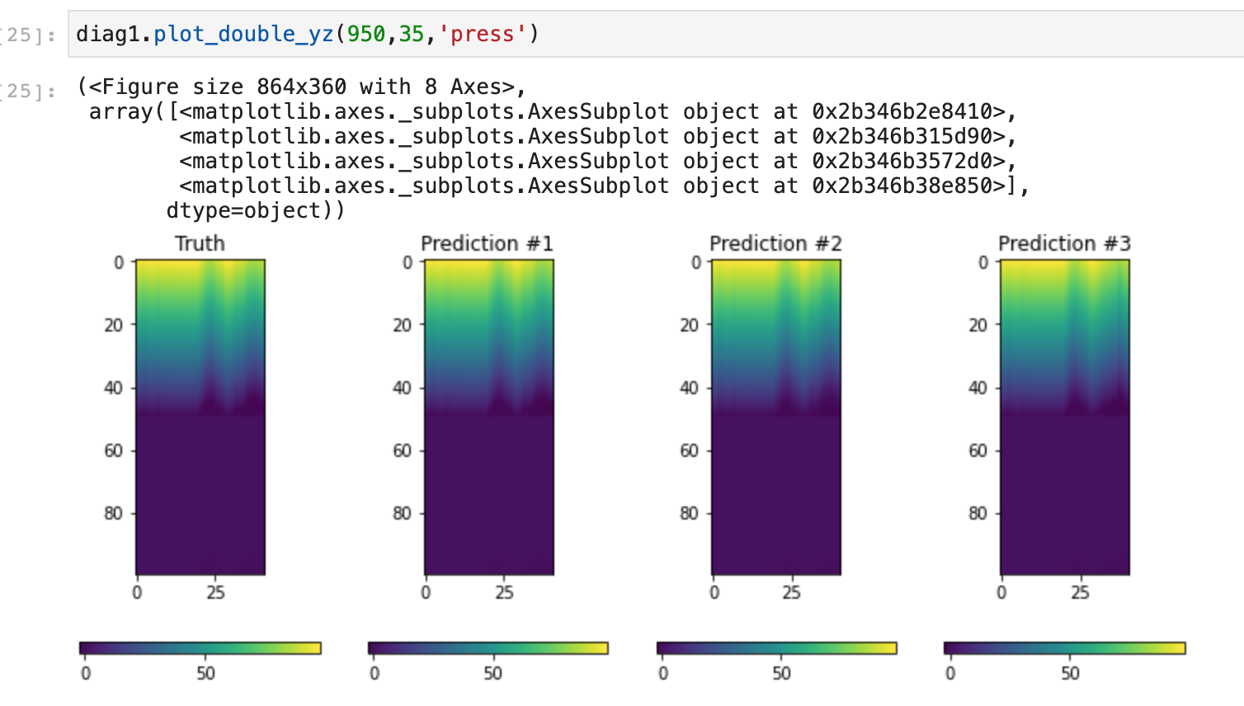
Follow the model architecture from Rasp et al.

Slide 20
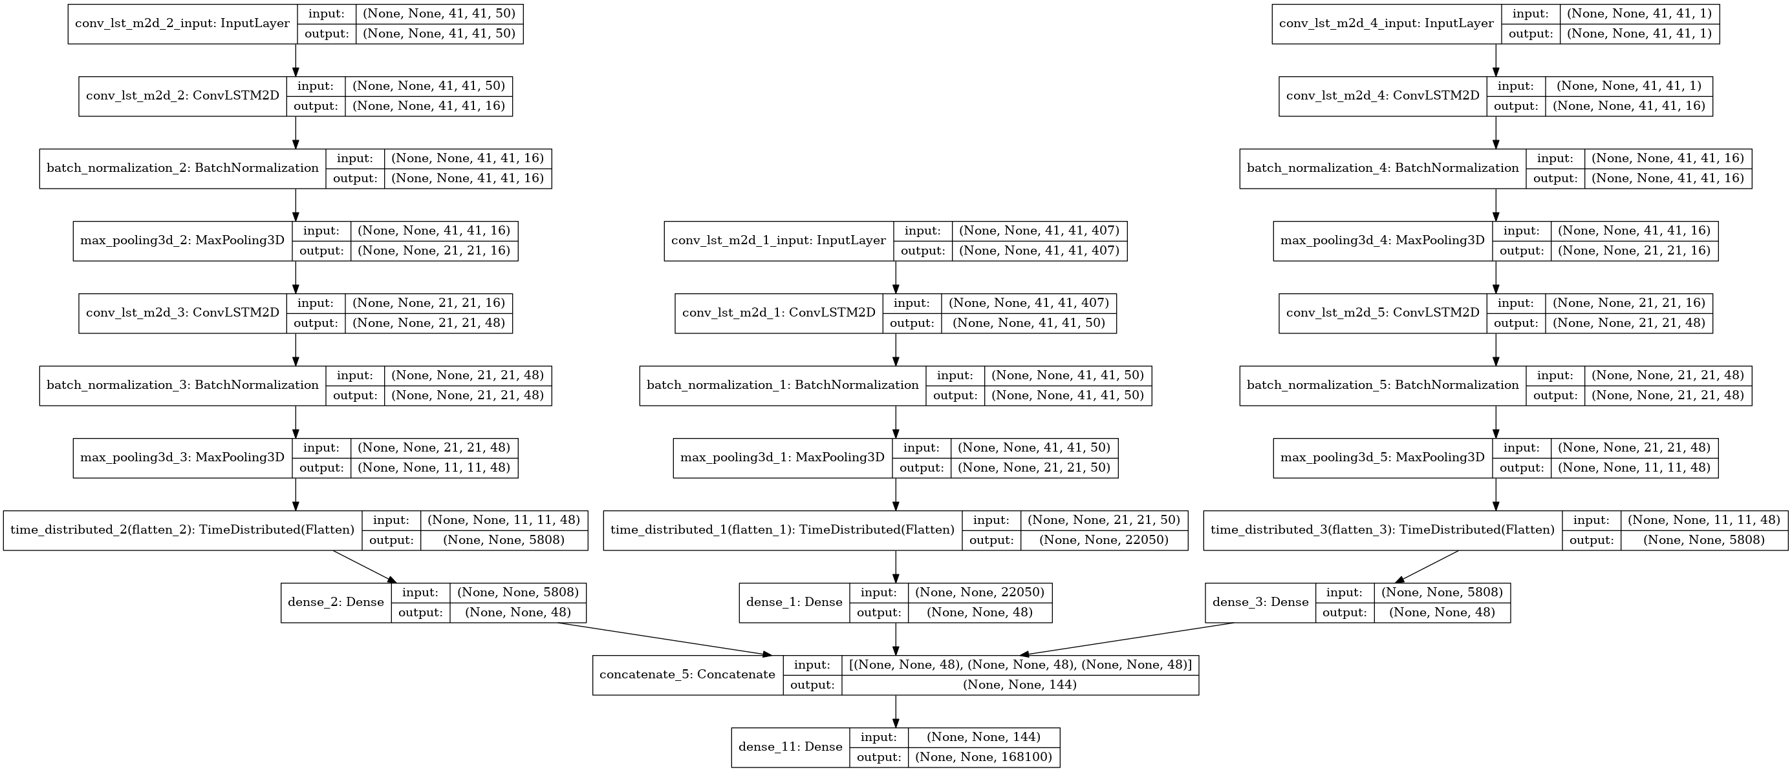
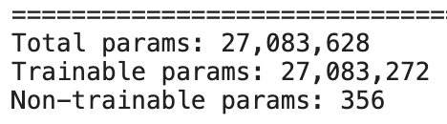
LSTM
Input: number of samples x number of time x ny x nx x (nz*n_feature)
Number of samples is the number of simulations that used for training

Slide 21
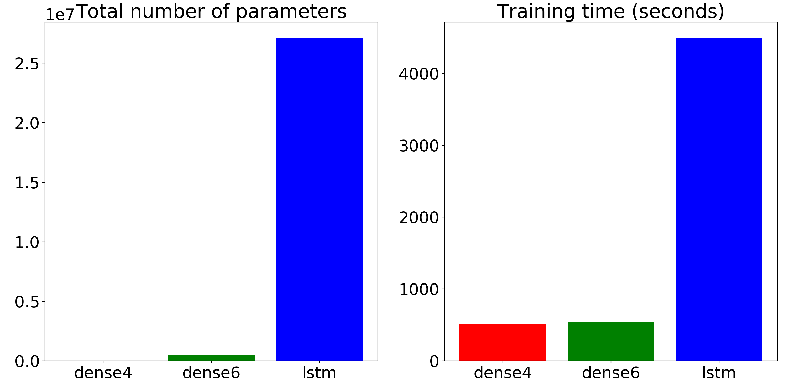
Model comparison

Slide 22
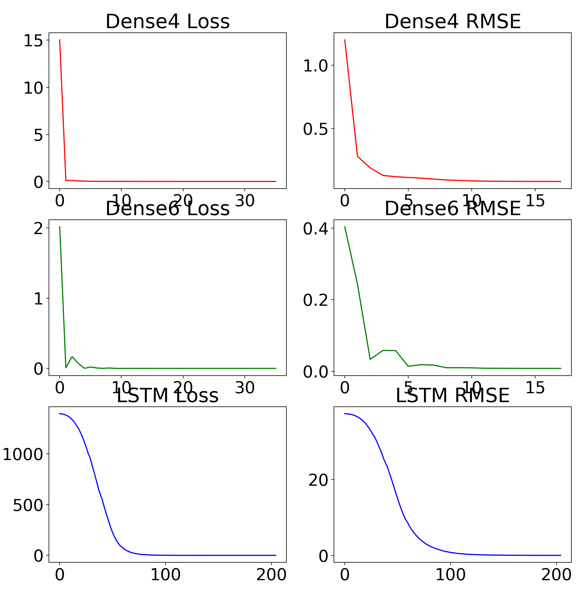
Model comparison

Slide 23
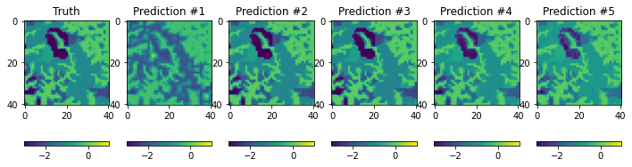
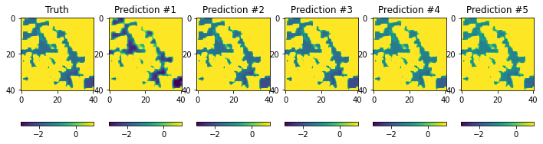
LSTM - Results
Pressure #300
Surface pressure
10-m depth pressure

Slide 24
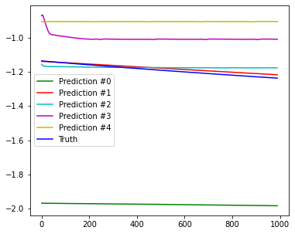
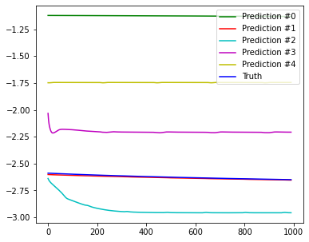
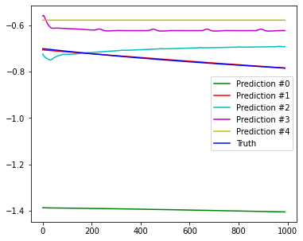
LSTM - Results
Hydrographs
Pixel 18_20
Pixel 15_20
Pixel 15_10

Slide 25
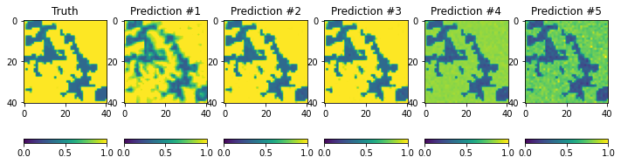
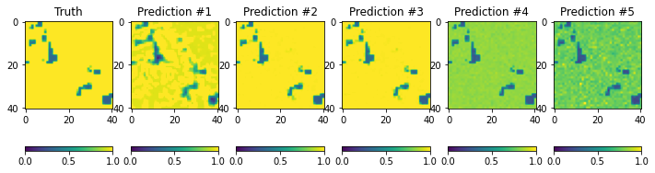
LSTM - Results
10-m depth saturation
Saturation
20-m depth saturation

Slide 26
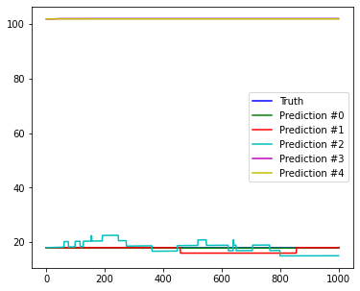
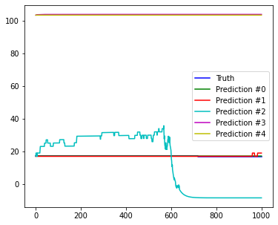
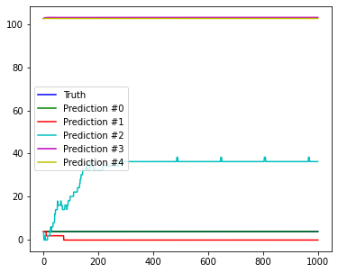
LSTM - Results
WTD
Pixel 18_15
Pixel 17_15
Pixel 15_20

